Slide 1

Similarity Joins in SPARQL Queries
Sebastián Ferrada
Institute for Foundational Research on Data
Universidad de Chile
sferrada@dcc.uchile.cl

Slide 2
0. What’s a Chile?

Slide 3

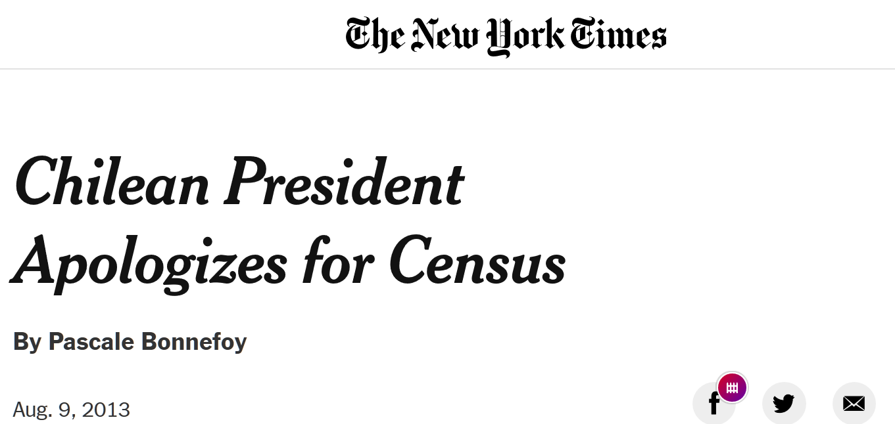
Chile
17 million people (as far as we know)

Slide 4
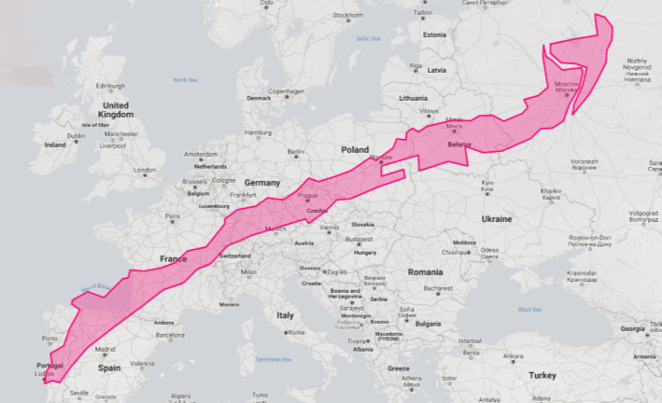
Chile
17 million people (as far as we know)
Super long: same distance from Lisbon to Moscow

Slide 5
Chile
17 million people (as far as we know)
Super long: same distance from Lisbon to Moscow
An economical oasis, allegedly

Slide 6

Chile
17 million people (as far as we know)
Super long: same distance from Lisbon to Moscow
An economical oasis, allegedly
Very nice weather, although the driest desert on Earth is expanding

Slide 7

Chile
17 million people (as far as we know)
Super long: same distance from Lisbon to Moscow
An economical oasis, allegedly
Very nice weather, although the driest desert on Earth is expanding
Best wine in the world (yes, even better tan French)

Slide 8
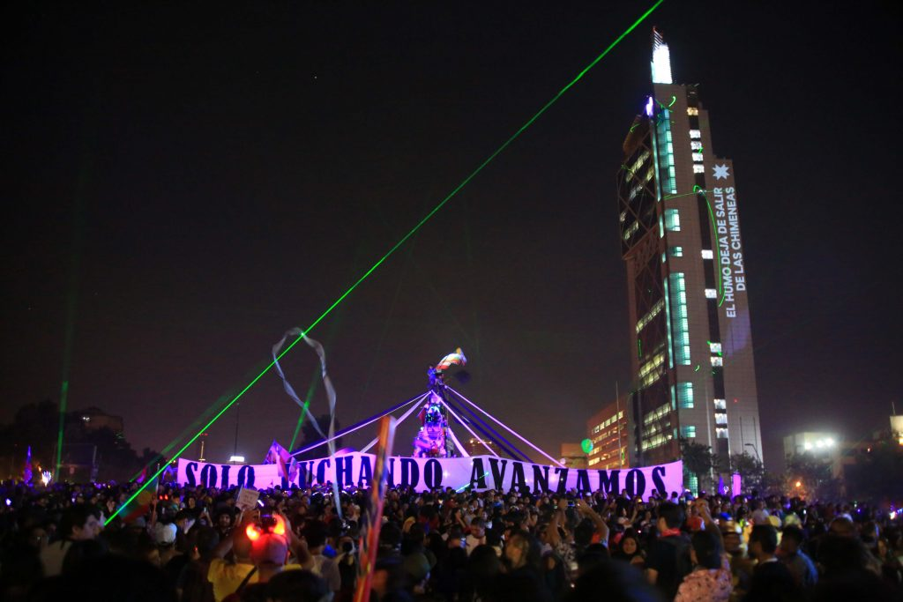
Chile
17 million people (as far as we know)
Super long: same distance from Lisbon to Moscow
An economical oasis, allegedly
Very nice weather, although the driest desert on Earth is expanding
Best wine in the world (yes, even better tan French)
Currently uprising against inequality

Slide 9
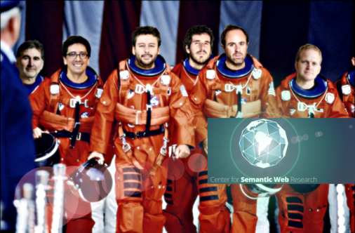

Institute for Foundational Research on Data
Not depicted:
Universidad de Chile

Slide 10
Institute for Foundational Research on Data
“We explore the foundational problems on data in order to understand its complexity, extract its value and turn it into a benefit for society”.
Universidad de Chile

Slide 11
1. Introduction

Slide 12

Exact Queries (on the Web)
nobel prize winners in literature

Slide 13
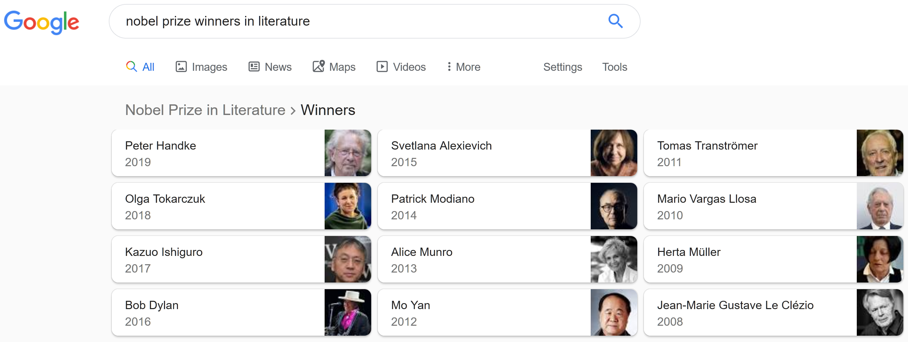

Exact Queries (on the Web)
Powered by
Semantic Web Technologies

Slide 14
Exact Queries (on the Web)
nobel prize winners in literature that fought in a war

Slide 15
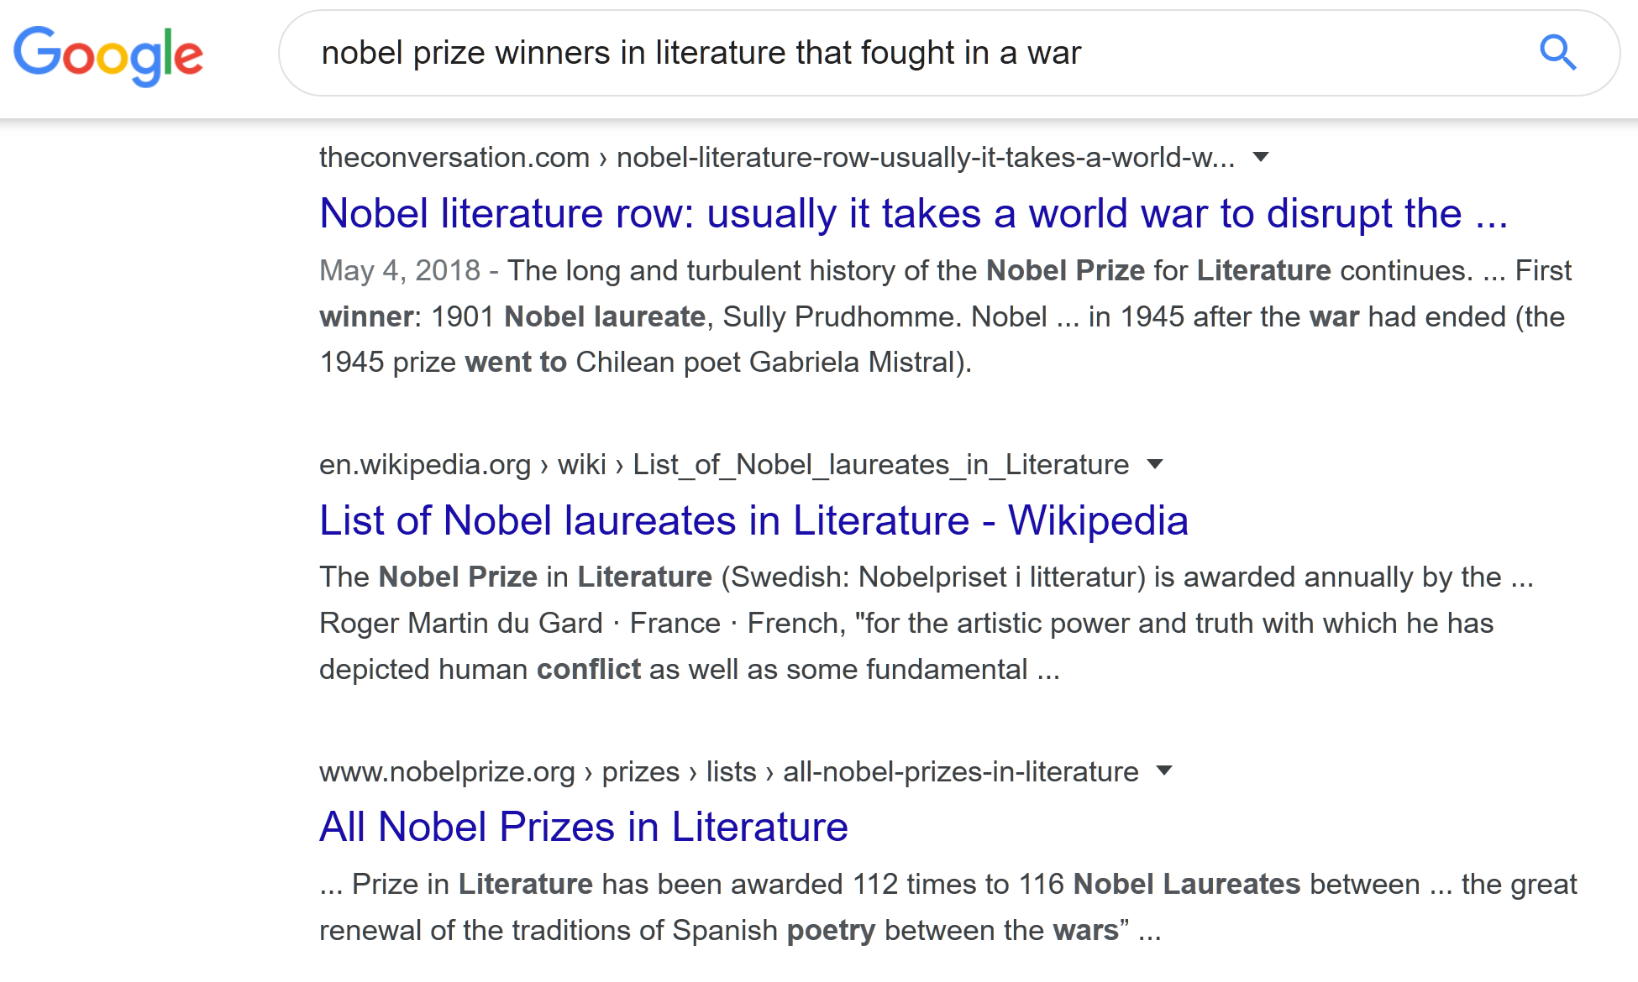
Exact Queries (on the Web)
Powered by
REGULAR Web Technologies

Slide 16
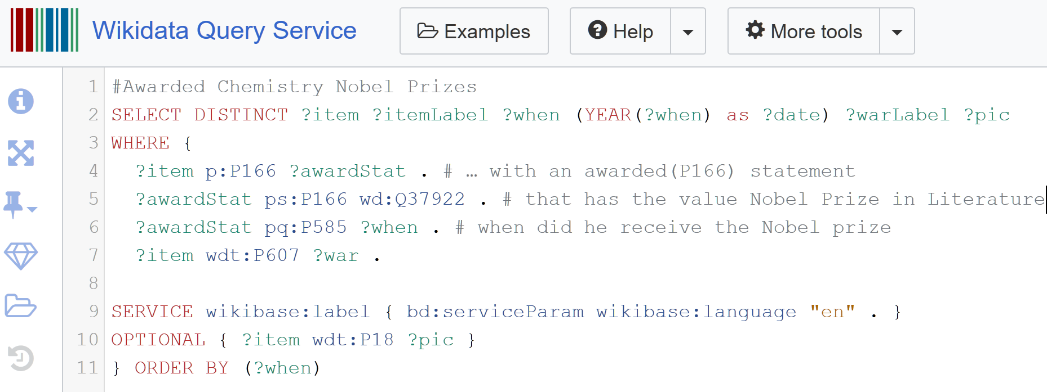
Exact Queries (on the Web)

Slide 17
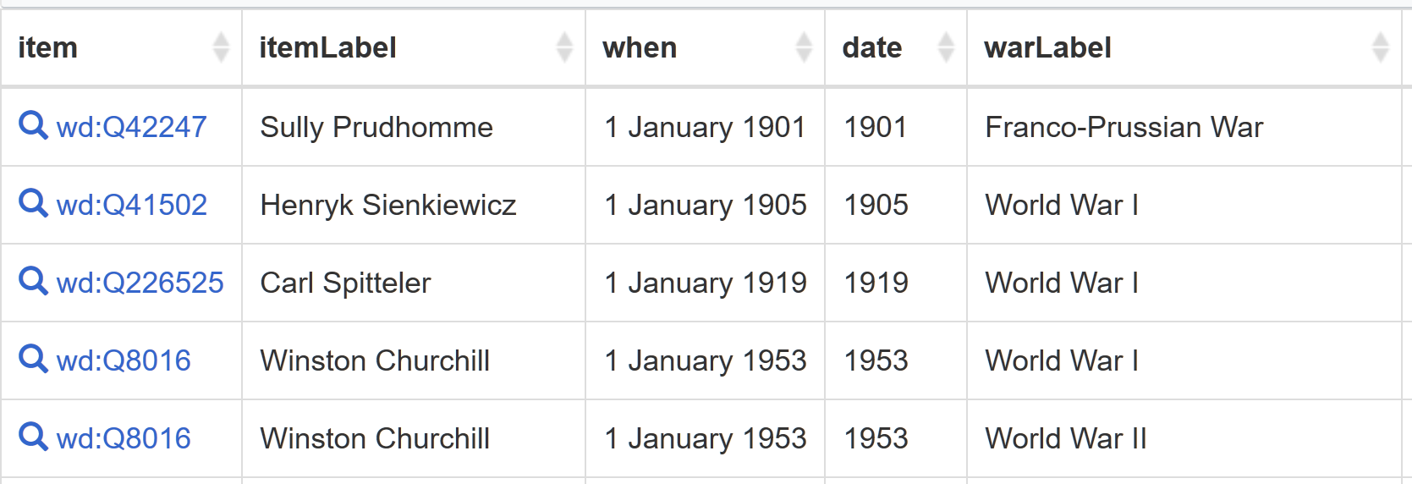
Exact Queries (on the Web)

Slide 18
Similarity Queries (on the Web)
Latin American countries with similar population and GDP to Ireland

Slide 19
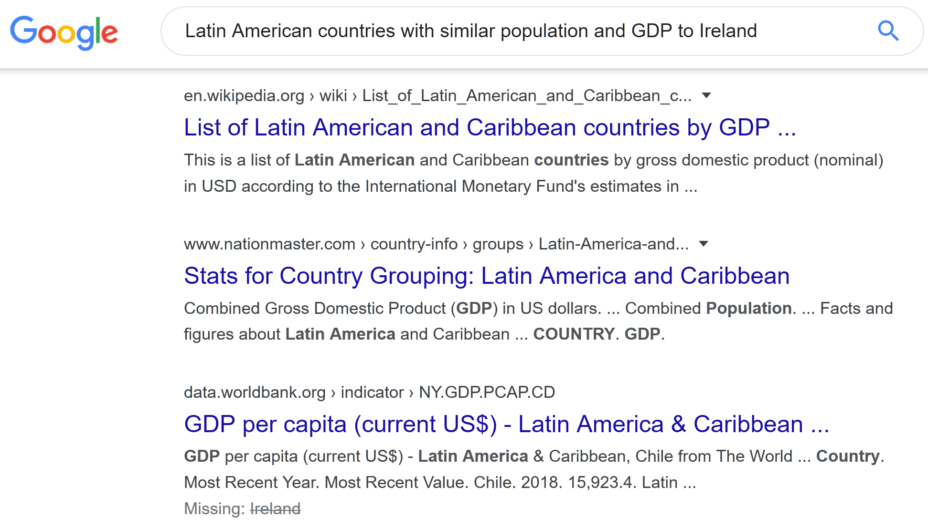
Similarity Queries (on the Web)

Slide 20
Similarity Queries (on the Web)
Churches similar to Versailles Palace

Slide 21
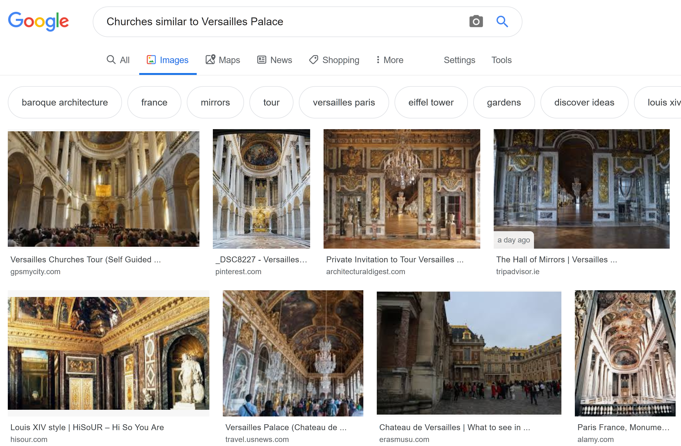
Similarity Queries (on the Web)

Slide 22
“Similarity” Queries (on the Web)
that one movie where the girl lives at walmart

Slide 23
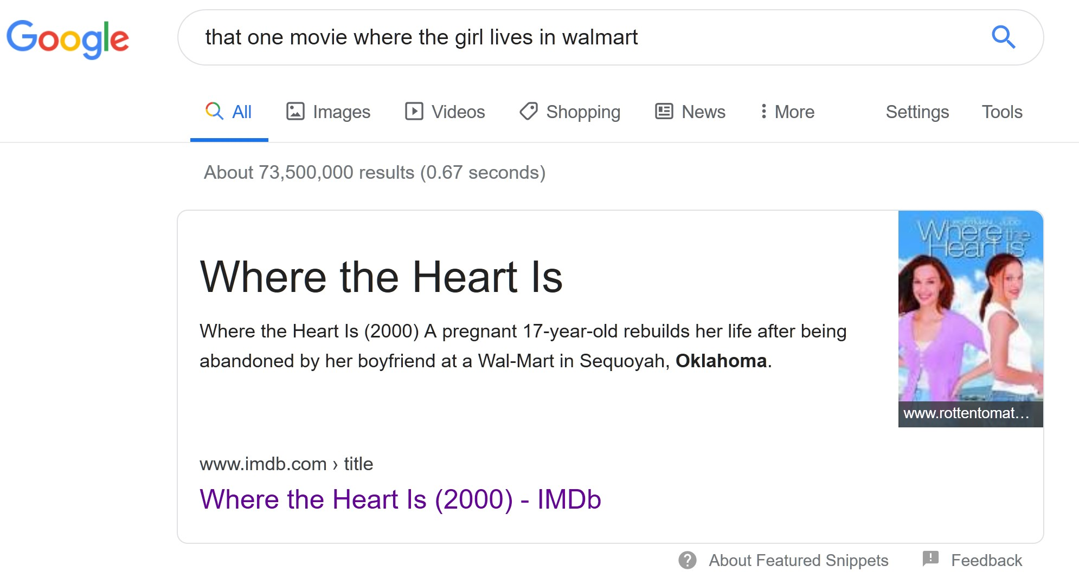
“Similarity” Queries (on the Web)

Slide 24
“Similarity” Queries (on the Web)
cheap hotels by the beach

Slide 25

“Similarity” Queries (on the Web)

Slide 26
The Problems
How to implement similarity joins, as an extension of the current Semantic Web Technologies/Standards?
How are these queries optimised?
How can users interact with this operator?
How can Multimedia benefit from this extension?

Slide 27
-1. Definitions

Slide 28
RDF Triples and Graphs
(subject, predicate, object)
(:Galway, :partOf, :Ireland)
(:Galway, :population, 79934)

Slide 29
SPARQL
SELECT ?country ?population ?capital WHERE{
?country rdf:type :Country ;
:population ?population ;
:hasCapital ?capital .
}

Slide 30
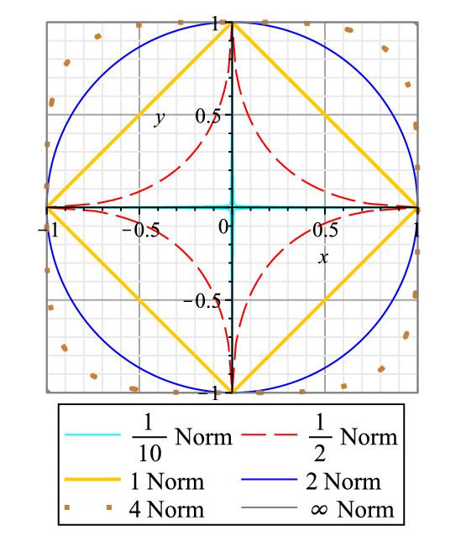
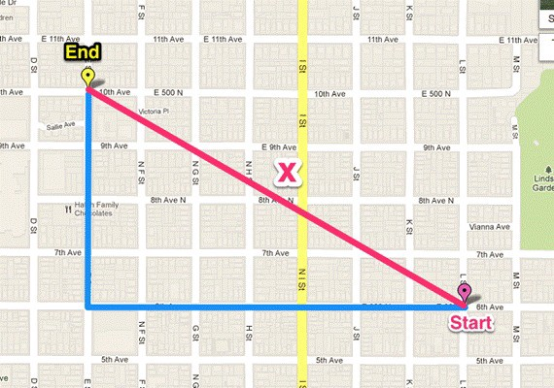
Metric Spaces
The unit ball in different Lp distances

Slide 31
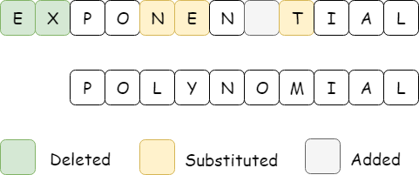
Metric Spaces
$$Lev\left(\text{exponential},\text{polynomial}\right)=6$$

Slide 32
Metric Spaces
A metric distance is always positive, symmetric
and holds the triangle inequality

Slide 33
Two objects are as similar as they are close in their metric space

Slide 34
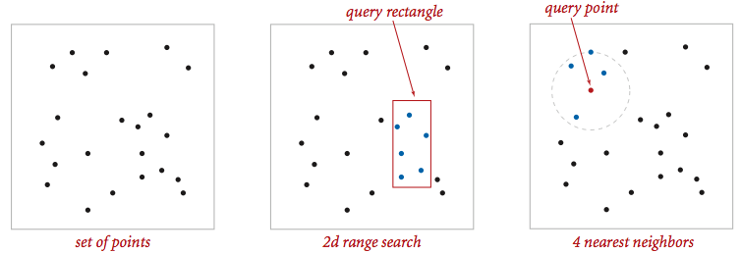
Range Search and Nearest Neighbours

Slide 35
Similarity Join
r
Find all pairs ( , ) that are at distance of at most r

Slide 36
Similarity Join
k=3
Find all pairs ( , ) where is one of the k nearest neighbours of

Slide 37
2. Current Approaches

Slide 38
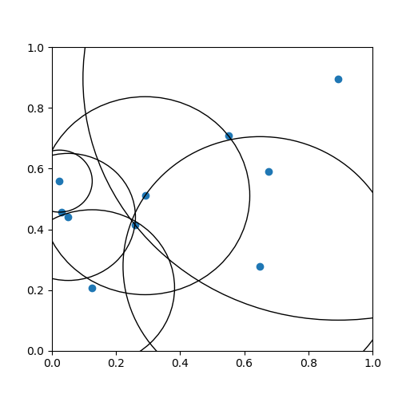
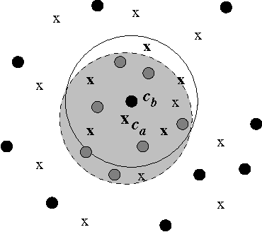
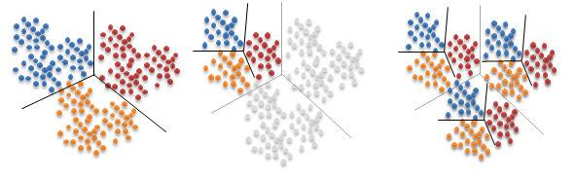
Multimedia Databases
Vantage-point trees
k-means trees
List of twin clusters

Slide 39
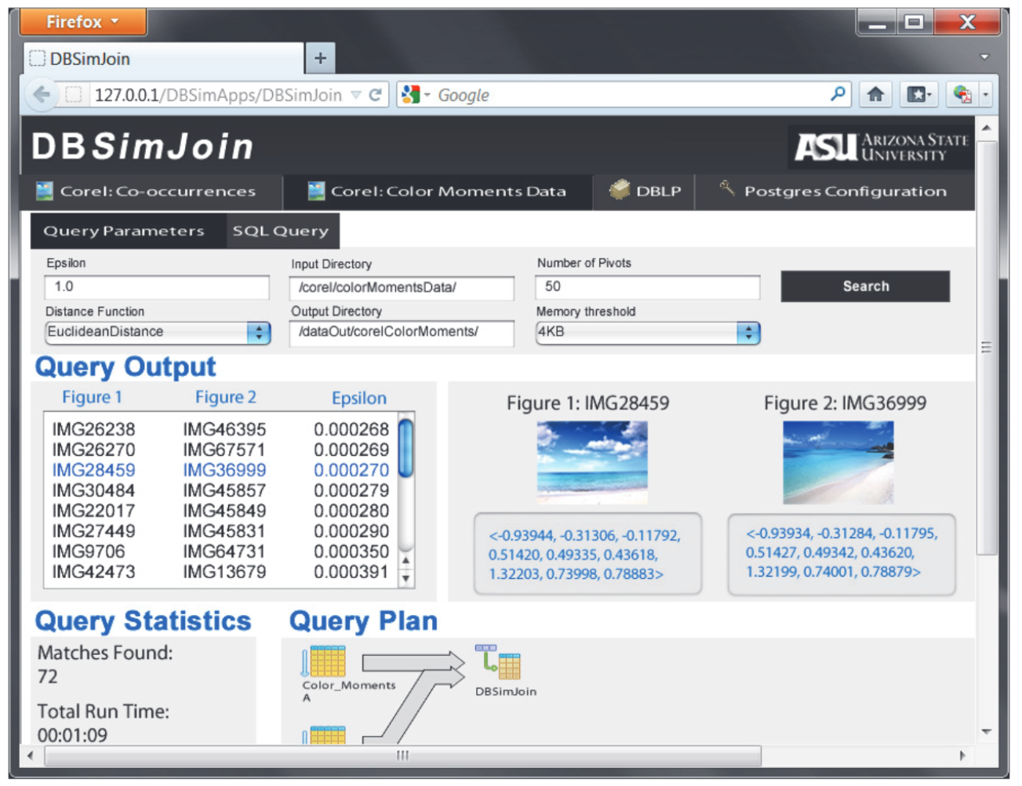
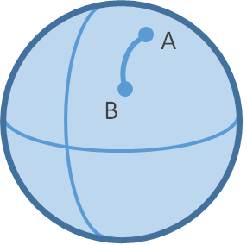
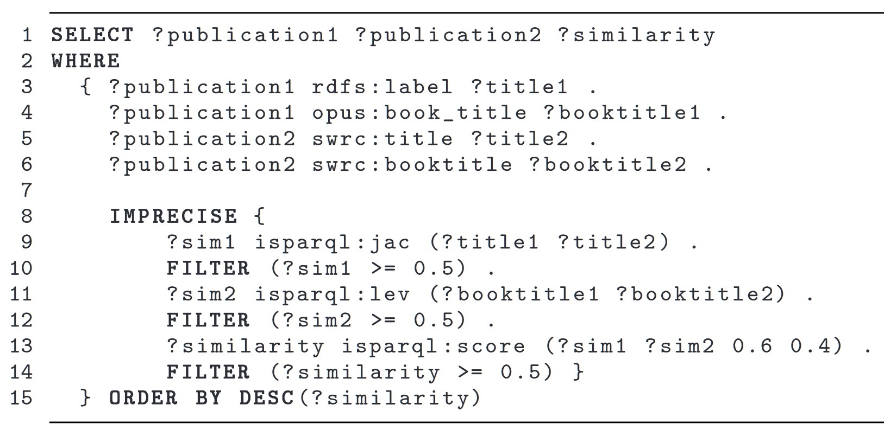
Ad hoc Systems
GeoSPARQL
iSPARQL
DBSimJoin

Slide 40
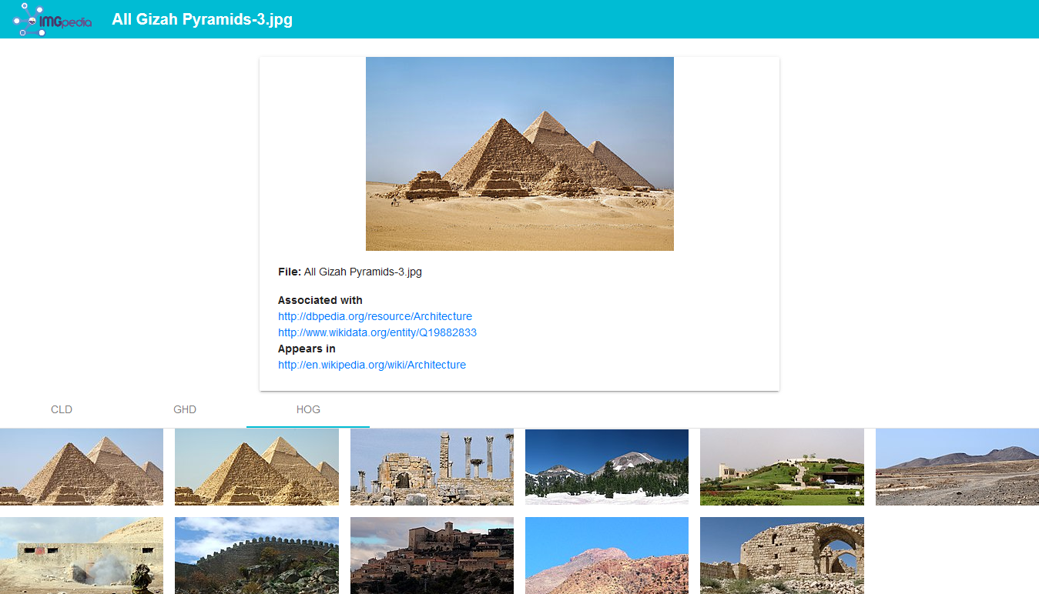
Static Similarity Relationships

Slide 41
3. Challenges

Slide 42
Size of the Data
A system supporting Similarity Joins especially requires scalability
It should provide efficient evaluation strategies, avoiding nested loops
When possible, it should index data and/or cache partial solutions

Slide 43
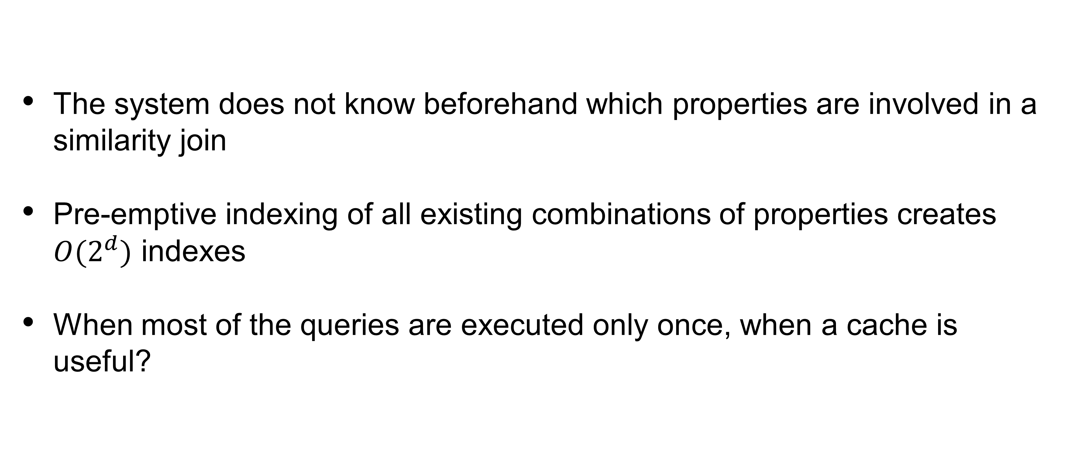
Dimension Agnostic Indexing
The system does not know beforehand which properties are involved in a similarity join
Pre-emptive indexing of all existing combinations of properties creates $O(2^{d})$ indexes
When most of the queries are executed only once, when a cache is useful?

Slide 44
Multi-valued Attributes
Data can contain information in various scales, multiple unit measures and/or registered at different times
e.g., The GDP of a country can be measured monthly, and stored in USD, in billions of USD or in the countries local currency
When such a property is involved in a similarity join, how to know which observations are relevant?

Slide 45
Missing Values
Under the Open-World paradigm of the Web, certain entities might not have values for all the properties of a similarity join
Is it necessary to consider incomplete entities? Are these missing values predictable?
How blank nodes should be interpreted?

Slide 46
Value Distribution
When different properties of a similarity join take orders-of-magnitude different value distribution (e.g., GDP in USD and life expectancy), are the lower-valued properties underrepresented in the distance function?
If so, how to provide a fairer distance?

Slide 47
4. Query Evaluation

Slide 48
Evaluation Pipeline
Query Writing
SPARQL
Parsing
Algebra
Result Iteration
Query Planning
Plan
Optimise Algebra
Optimised Algebra
Query Execution
Result
Iterator

Slide 49
5. Syntax Extension

Slide 50
Natural Similarity Join
SELECT <proj_vars> WHERE {
{<bgp1>}
SIMILARITY JOIN
TOP k | WITHIN r
WITH DISTANCE <d>
AS <variable>
{<bgp2>}
}

Slide 51
Natural Similarity Join
SELECT ?p1 ?p2 ?d WHERE {
{?p1 wdt:P31/wdt:P279* wd:Q6256 ; #countries
wdt:P4010 ?GDP ;
wdt:P1081 ?hdi ;
wdt:P30 wd:Q46 } #in Europe
SIMILARITY JOIN
TOP 1 WITH DISTANCE manhattan AS ?d
{?p2 wdt:P31/wdt:P279* wd:Q6256 ; #countries
wdt:P4010 ?GDP ;
wdt:P1081 ?hdi ;
wdt:P361 wd:Q12585 }} #in latam
Latin American countries with similar GDP and hdi of European Countries

Slide 52
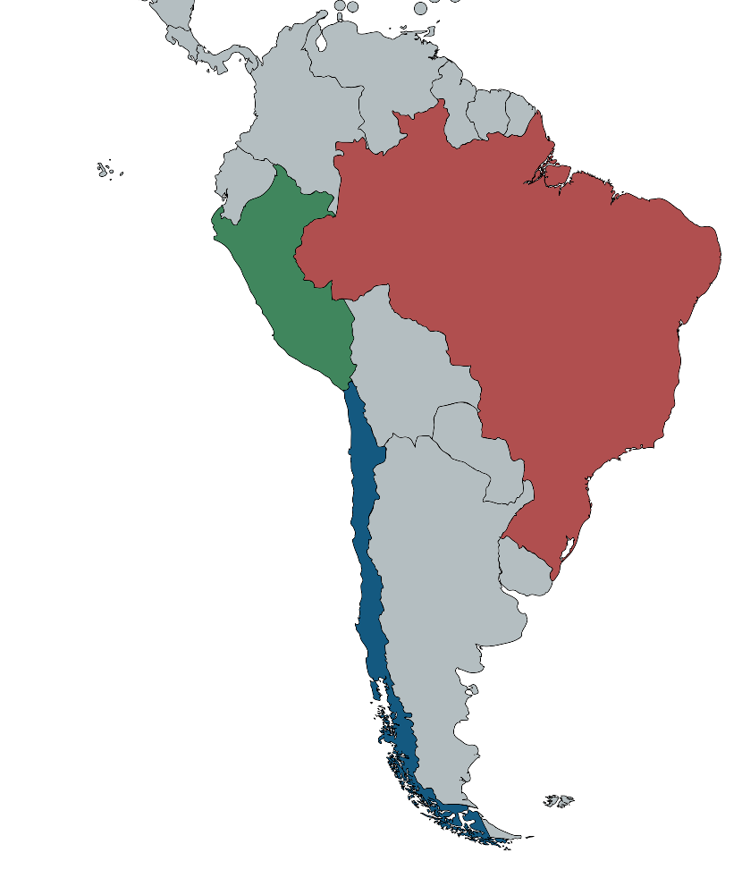
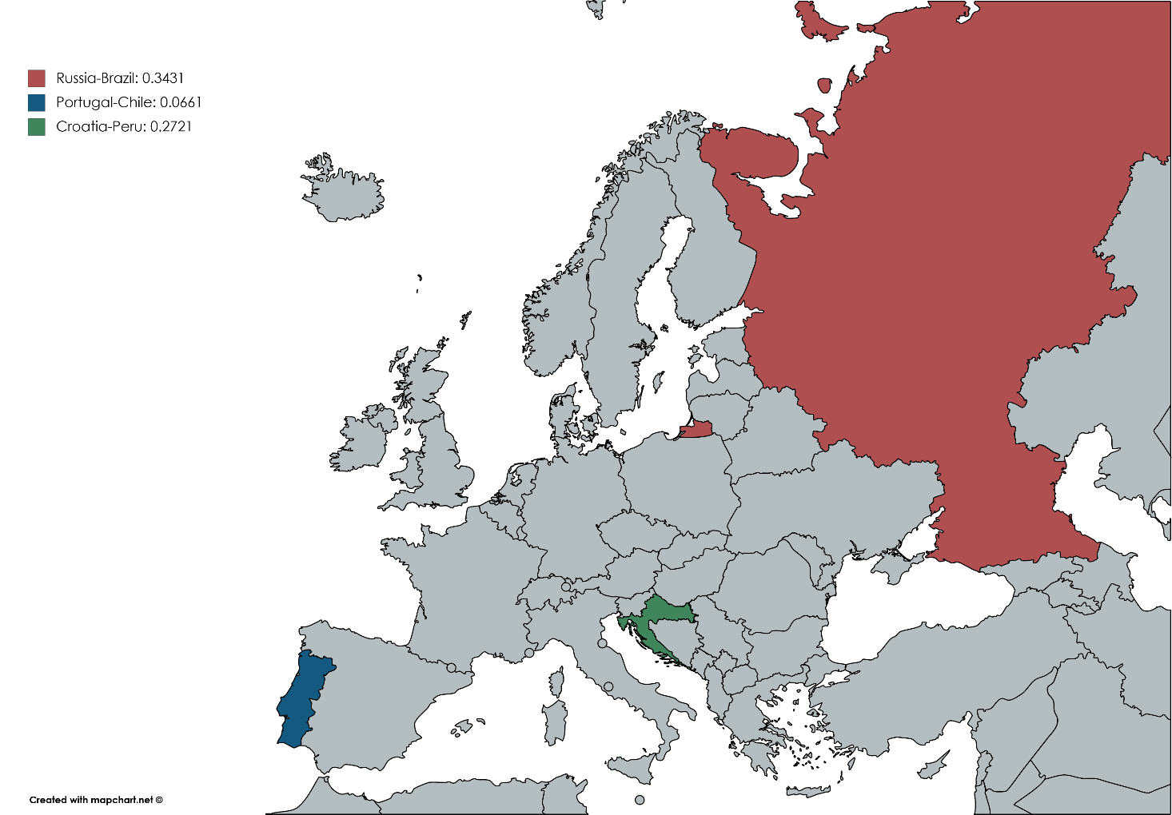
Natural Similarity Join
?p1 | ?p2 | ?d
Russia | Brasil | 0.3431
Croatia | Peru | 0.2721
Portugal | Chile | 0.0661

Slide 53
6. Query Planning and Optimisation

Slide 54
Rewriting Rules
Sort
Sort
Aggregate
Aggregate
Filter
Join
Join
Filter
Scan Q1
Scan Q2
Scan Q1
Scan Q2

Slide 55
Query Overlap Cache
SELECT ?p1 ?p2 ?d WHERE {
{?p1 wdt:P31/wdt:P279* wd:Q6256 ; #countries
wdt:P4010 ?GDP ;
wdt:P1081 ?hdi ;
wdt:P30 wd:Q46 } #in Europe
SIMILARITY JOIN
TOP 1 WITH DISTANCE manhattan AS ?d
{?p2 wdt:P31/wdt:P279* wd:Q6256 ; #countries
wdt:P4010 ?GDP ;
wdt:P1081 ?hdi ;
wdt:P361 wd:Q12585 }} #in latam

Slide 56
7. Implementation

Slide 57
Apache Jena
An Open Source Java Framework for building Semantic Web/Linked Data applications
We added a parser that manages the Similarity Join case:
It parses the two components as two regular SELECT queries and stores the parameters of the JOIN
Takes control only to execute the similarity join, integrated seamlessly to the original workflow
http://github.com/scferrada/jena

Slide 58
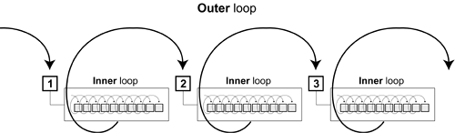
Similarity Join Strategies
Nested Loop
Vantage-point trees
FLANN

Slide 59
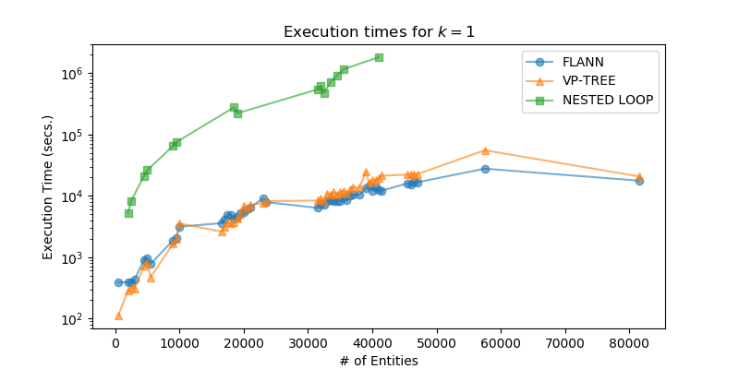
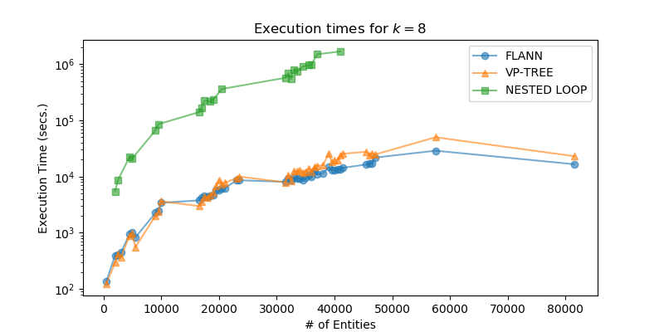
Strategy Comparison

Slide 60
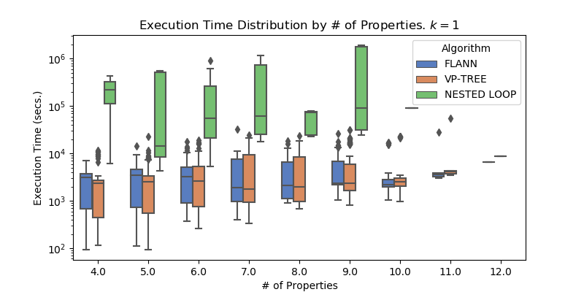
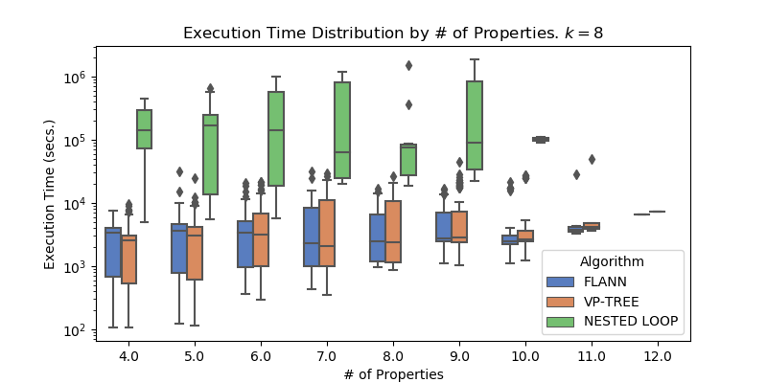
Strategy Comparison

Slide 61
DBSimJoin
We compare our RDF/SPARQL implementation with this RDB/SQL system using the data and settings discussed in the paper of DBSimJoin
DBSimJoin uses only self-similarity joins and implements only one strategy, we compare with our vp-tree implementation
We loaded the data offline into both systems, applying ad hoc transformations
We performed increasingly larger range similarity joins, measure the execution time and number of answers

Slide 62
DBSimJoin
Query Radius | # of responses | DBSimJoin Exec. Time | Jena-vp Exec. Time
0.001 | 68,424 | 19.97 | 5.32
0.01 | 68,462 | 21.08 | 5.50
0.1 | 68,498 | 50.13 | 7.51
0.3 | 72,920 | 420.10 | 21.53
0.39 | 92,444 | 1,388.50 | 35.31
0.4 | 121,826 | - | 36.61
1 | 11,699,572 | - | 262.38

Slide 63
8. (Query) Use Cases

Slide 64
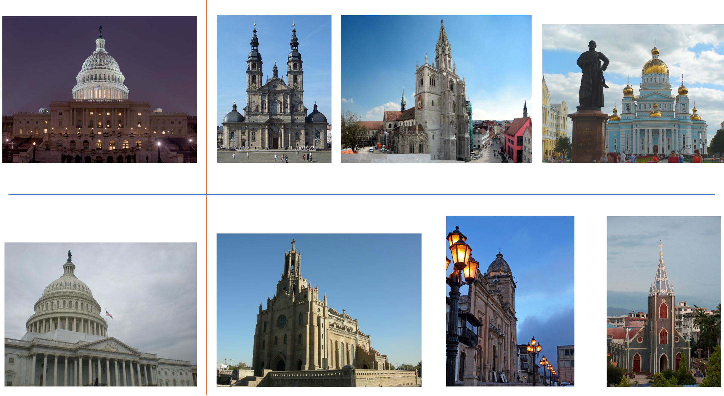
Image Similarity
Images of churches similar to images of the US Capitol building

Slide 65
Aggregated Dimensions
Country | Population | Total City Pop. | Max. City Pop. | Distance
Benin | 10,323,474 | 31,444 | 31,444 | 0.0015
Switzerland | 8,211,700 | 30,205 | 30,205
Thailand | 65,931,550 | 5,871,618 | 5,696,409 | 0.0421
Myanmar | 53,259,018 | 8,975,549 | 5,430,000
Similar Countries in terms of their population, city population,
and the population of their most inhabited city

Slide 66
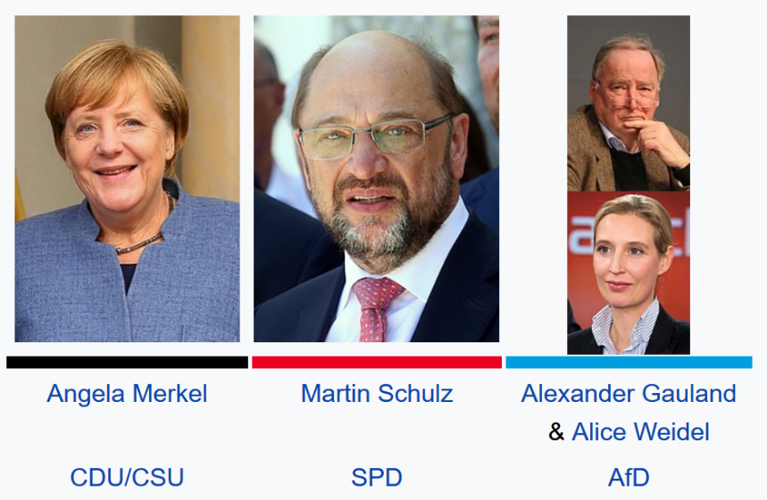
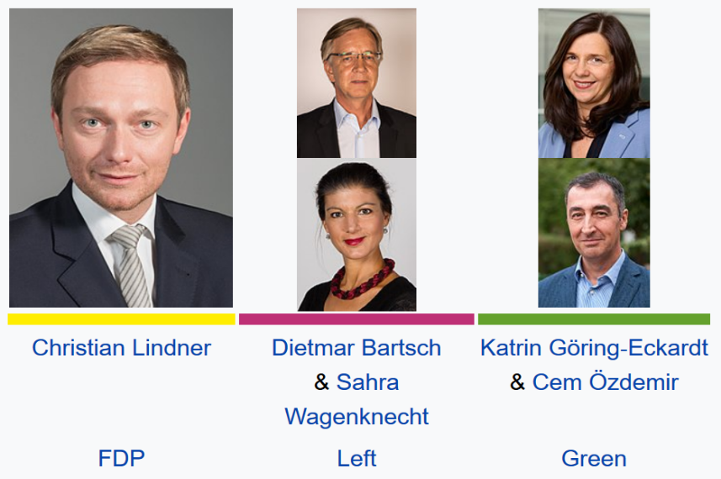
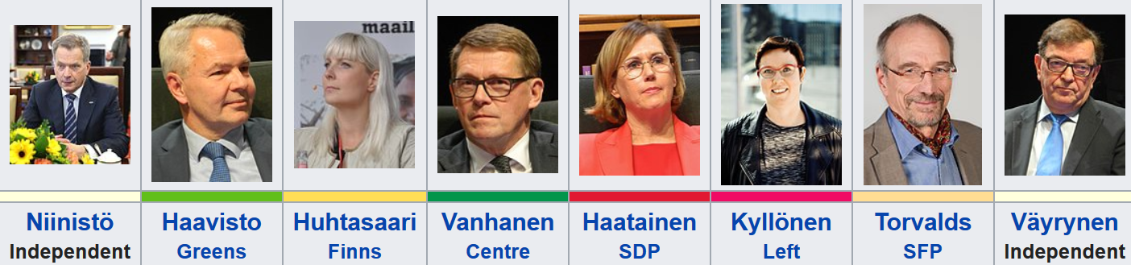
Aggregated Dimensions
(Germany 2017)
(Finland 2018)
The two most similar elections in terms of number of candidates,
different parties and different political philosophies

Slide 67
Research Use Cases
Data Integration
Entity Linking
Stream Data
Event Detection
Query Relaxation
“LeDecision”
“The Akron Hammer”
wikidata:LeBron_James
“The L-Train”
“LeBron Raymone James”

Slide 68
9. The (near) Future

Slide 69
Near Future Directions
Experiment further with query optimisation
Apply extension to other domains
Evaluate the proposed syntax
And, most importantly...

Slide 70
Near Future Directions
Find a new interesting use-case!!!
Really, call me if you think you can use any of this!

Slide 71
Thanks a million!
Follow me anywhere @ferradest
Drop me a line at sferrada@dcc.uchile.cl

